Slide 1

107 Boosting Techniques
Sunil Gorantla

Slide 2
What is Boosting ?
Boosting is an ensemble technique in machine learning that focuses on improving the accuracy of a predictive model by combining multiple weak learners to form a strong learner. Here's how boosting works:

Slide 3
Types of Boosting Algorithms:
AdaBoost (Adaptive Boosting): One of the earliest and simplest forms of boosting, where the emphasis is on correcting the misclassifications made by the previous model.
Gradient Boosting: A more advanced method where each new model is trained to minimize the residual errors (the difference between the actual and predicted values) from the previous models.
XGBoost (Extreme Gradient Boosting): An optimized version of gradient boosting that is faster and more efficient, often used in competitions like Kaggle.

Slide 4
Challenges:
Computationally Intensive: Since boosting involves training multiple models sequentially, it can be computationally expensive.
Sensitive to Noisy Data: If the dataset contains a lot of noise, boosting can overemphasize these errors, leading to overfitting.

Slide 5
Example Y_target = y_pred_base + Residual
Feature X | Target y | Y_pred | Residual | Y_pred_m1
2 | 3 | 8.4 | -5.4 | -2.7
3 | 6 | 8.4 | -2.4 | -2.7
4 | 8 | 8.4 | -.4 | -2.7
5 | 11 | 8.4 | 2.6 | 4.1
6 | 14 | 8.4 | 5.6 | 4.1

Slide 6





SR = (sum(res))^2/(#no of res + lambda)
SR_parent = 0
SR_child1 = 22.41
SR_child2 = 33.62
Gain = abs(SR_parent - (SR_child1 + SR_child2))
Gain = 56.03
Y_tar = y_pred_base + y_pred_m1
X = 2,3,4
Res = -5.4, -2.4, -0.4
X = 5,6
Res = 2.6, 5.6

Slide 7
Approach 1
Y = w1*x1 + w2*x2 …… wi*xi + w0
MSE = Sum((y_actual – y_pred)^2) = 5000
W1 = 10000
Approach 2
K = 1
MSE = Sum((y_actual – y_pred)^2) + k*(w1+w2 + w3 …wi)
W1 = ????

Slide 8










X = 2,3,4
Y = 3,6,8
Y_pred =5.6
X = 5,6
Y = 11,14
Y_pred = 12.5
X = 2,3
Y = 3,6
Y_pred = 4.5
X = 4
Y = 8
Y_pred = 8

Slide 9


Slide 10
Step 1: Base Model (Initial Prediction)
Base Prediction: Start with an initial prediction, typically the mean of the target values.
Mean of y=8.4
The base model predicts 8.4 for every data point.
Compute residuals from Base Model

Slide 11
Step 2: First Model M1
Calculate Residuals: Subtract the base prediction from actual values.
Residuals for each row:
Row 1: 3−8.4=−5.43
Row 2: 6−8.4=−2.46
Row 3: 8−8.4=−0.4
Row 4: 11−8.4=2.6
Row 5: 14−8.4=5.6

Slide 12
Comparison
Bagging
Boosting
Parallel
Equal weight
Can use fully grown models. Ex fully grown trees can be used in random forest.
Sequential
All models cannot equal weightage
Weak Learners like stumps

Slide 13







Y = y1+ 0.2*y2 + 0.1*y3

Slide 14
Ada-boost
Age | BMI | Gender |  | Pred (first model) | residual
25 | 24 | M | 1 | M | 0
41 | 19 | M | 1/8 | M | 0
43 | 25 | F | 1/8 | M | 1
22 | 31 | F | 1/8 | F | 0
28 | 22 | F | 1/8 | M | 1
31 | 30 | M | 1/8 | M | 0
52 | 26 | M | 1/8 | F | 1
41 | 26 | F | 1/8 | F | 0

Slide 15
10000 data points
Equal Weightage to all data points
500 data points → Build a model → 400 correct predictions and 100 wrong predictions. → Update all the weights giving more weightage to wrongly predicted rows.
No prediction, correctly predicted, and wrongly predicted.

Slide 16







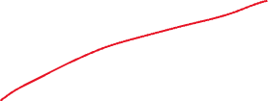

Slide 17
Working
Step 1: Initialize weights equally for all training samples.
Step 2: Train a weak classifier on the weighted dataset.
Step 3: Increase weights of incorrectly classified samples to focus the next classifier on these errors.
Step 4: Combine weak classifiers by their performance to form the final strong classifier.

Slide 18
Gradient Boosting
Feature | AdaBoost | Gradient Boosting
Algorithm Focus | Adjusts the weights of misclassified samples to focus on harder cases. | Optimizes the loss function by fitting new models to the residual errors of the previous models.
Base Learner | Typically uses simple weak learners like decision stumps. | Can use any differentiable model, commonly decision trees.
Error Handling | Misclassified samples receive higher weights in subsequent models. | Subsequent models are trained to correct the residual errors from previous models.
Weight Update | Updates the weights of samples based on whether they are correctly classified. | Does not explicitly update weights; focuses on reducing the overall loss.
Classifier Combination | Combines classifiers based on their weighted majority vote. | Combines classifiers by summing their outputs, adjusted by a learning rate.
Learning Rate | Implicitly handled through the weight adjustment process. | Explicitly defined as a parameter to scale the contribution of each learner.
Sensitivity to Outliers | More sensitive to outliers as they receive higher weights. | Less sensitive to outliers as it gradually reduces the error over iterations.
Application | Effective for binary and multi-class classification problems. | Versatile, used for both regression and classification tasks.
Performance | Good performance with simple models; may struggle with complex problems. | Tends to perform better on complex problems due to iterative refinement.
Computational Cost | Generally faster with fewer iterations but can be slower with large datasets. | More computationally expensive due to iterative nature and complex models.

Slide 19







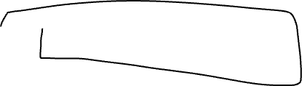






Slide 20
Catboost
Symmetric tree
Encoding Categorical features:
Ordered target based encoding
MVP
Lightgbm
leaf based
Encoding Categorical features:
Bins/Bucketing
Sampling Technique:
GOSS
Xgboost
Level Based
Encoding Categorical features:
Manual
Sampling: Bootstrap (Random Sample)

Slide 21





Training data set size: 50,000

Slide 22
Ordered Target based encoding
(Count + prior)/(Max Count + 1)
Age | BMI (Target) | Gender | Target based encoding
25 | 24 | M | 24.75
41 | 19 | M | 24.75
43 | 25 | F
22 | 31 | F
28 | 22 | F
31 | 30 | M |  | (2+0.5)/(3 + 1)
52 | 26 | M
41 | 26 | F

Slide 23
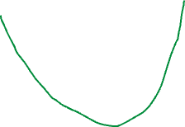
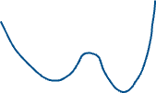
Y = w*x + c
Y = 1000*x + 500
Cost function = Summation((y_act – y_pred)^2))
Parameters = w, c
Step w = 0 , c= 0
Cost function = 1000

Slide 24

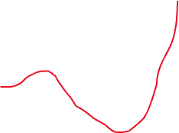
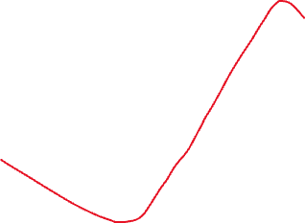
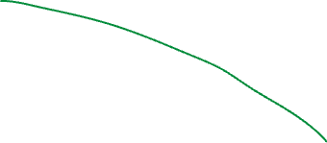
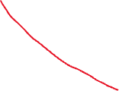
W = 0, c = 0, cost_function = 10000
Step1 : w = 10, c =0, cost_function = 9500
Step99: w = 100, c =0, cost_function = 5500
W_new = W_old + lr* slope

Slide 27
Loss function = RMSE + l^2*weights

